Slide 1
Multi, Poly Regression and Model Selection Part B: Multi-regression

Slide 3
Multiple Linear Regression
If you have to guess someone's height, would you rather be told
Their weight, only
Their weight and gender
Their weight, gender, and income
Their weight, gender, income, and favorite number
Of course, you'd always want as much data about a person as possible. Even though height and favorite number may not be strongly related, at worst you could just ignore the information on favorite number. We want our models to be able to take in lots of data as they make their predictions.

Slide 4
Response vs. Predictor Variables
X
predictors
features
covariates
Y
outcome
response variable
dependent variable
TV | radio | newspaper | sales
230.1 | 37.8 | 69.2 | 22.1
44.5 | 39.3 | 45.1 | 10.4
17.2 | 45.9 | 69.3 | 9.3
151.5 | 41.3 | 58.5 | 18.5
180.8 | 10.8 | 58.4 | 12.9
n observations
p predictors

Slide 5
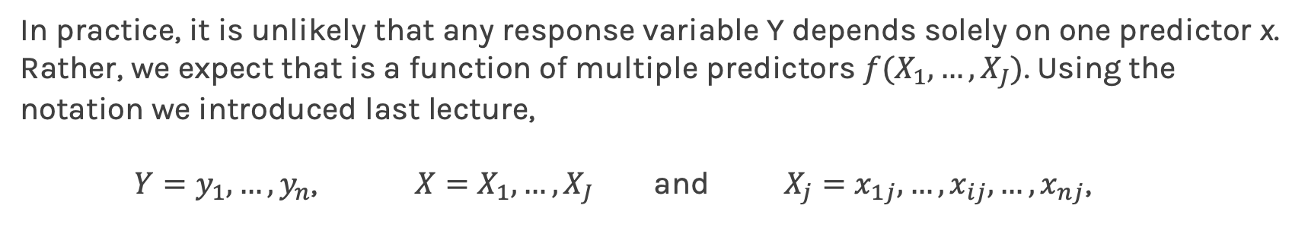
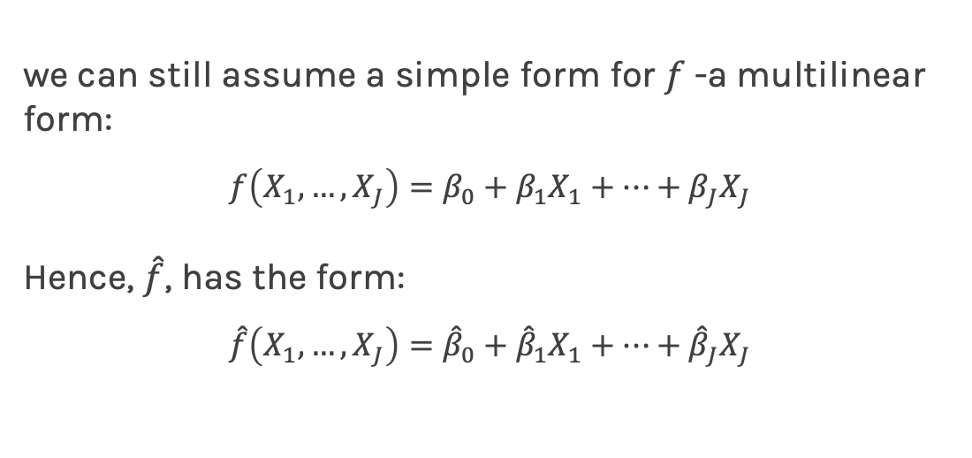
Multilinear Models
In practice, it is unlikely that any response variable Y depends solely on one predictor x. Rather, we expect that is a function of multiple predictors $f(X_{1},…,X_{J})$. Using the notation we introduced last lecture,
$Y=y_{1},…,y_{n}$, $X=X_{1},…,X_{J}$ and $X_{j}=x_{1j},…,x_{ij},…,x_{nj}$,
we can still assume a simple form for $f$-a multilinear form:
$$f\left(X_{1}, …, X_{J}\right)=β_{0}+β_{1}X_{1}+…+β_{J}X_{J}$$
Hence, $\hat{f}$, has the form:
$$\hat{f}\left(X_{1}, …, X_{J}\right)={\hat{β}}_{0}+{\hat{β}}_{1}X_{1}+…+{\hat{β}}_{J}X_{J}$$

Slide 6
Multiple Linear Regression
Given a set of observations,
the data and the model can be expressed in vector notation,
Notes:
We need a figure here

Slide 7

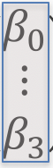
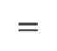

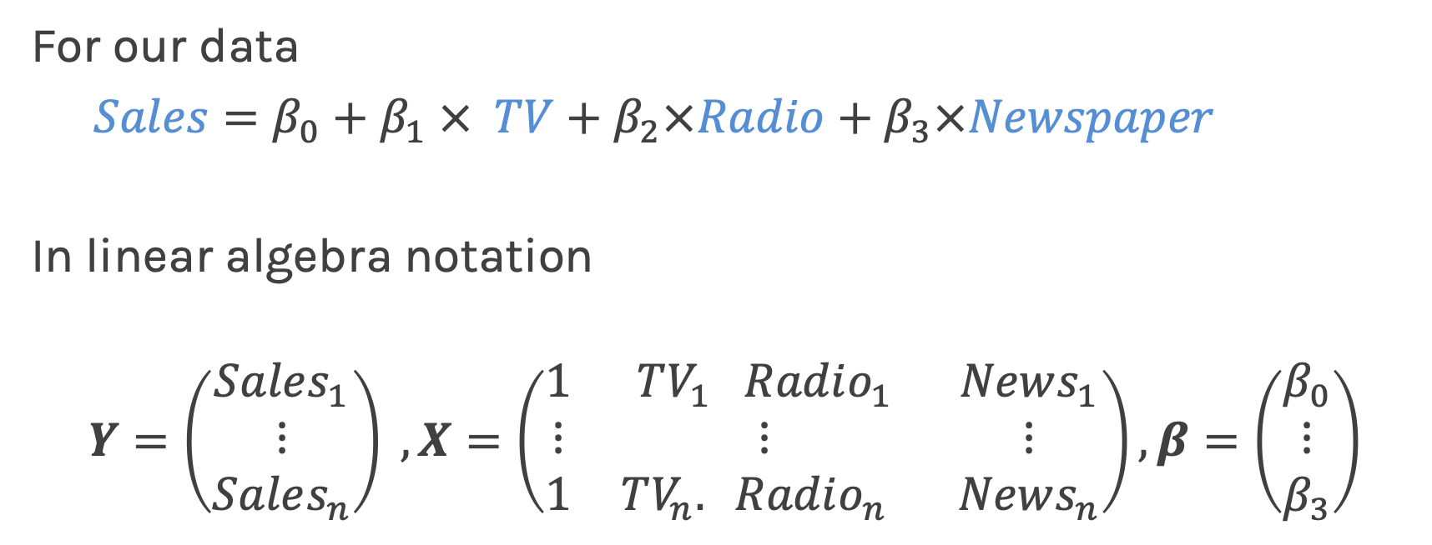
Multilinear Model, example
For our data
$Sales=β_{0}+β_{1} × TV+β_{2}×Radio+β_{3}×Newspaper$
In linear algebra notation
$$Y=\left(\begin{matrix}Sales_{1} \\ ⋮ \\ Sales_{n}\end{matrix}\right) , X=\left(\begin{matrix}1 & TV_{1} Radio_{1} & News_{1} \\ ⋮ & ⋮ & ⋮ \\ 1 & TV_{n}. Radio_{n} & News_{n}\end{matrix}\right), β=\left(\begin{matrix}β_{0} \\ ⋮ \\ β_{3}\end{matrix}\right)$$
$$=$$
$$×$$

Slide 8
Multiple Linear Regression
The model takes a simple algebraic form:
We will again choose the MSE as our loss function, which can be expressed in vector notation as
Minimizing the MSE using vector calculus yields,
Notes:
We need a figure here

Slide 9
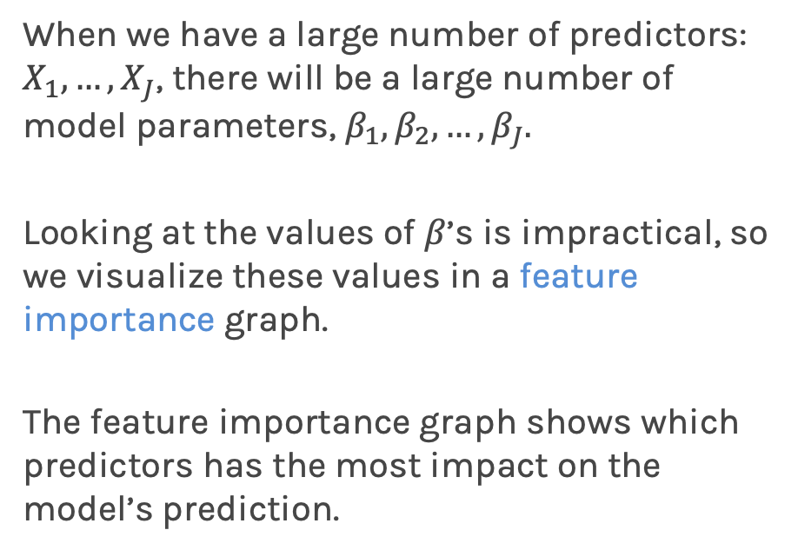
Interpreting multi-linear regression
For linear models, it is easy to interpret the model parameters.
When we have a large number of predictors: $X_{1},…,X_{J}$, there will be a large number of model parameters, $β_{1}, β_{2},…,β_{J}.$
Looking at the values of $β$’s is impractical, so we visualize these values in a feature importance graph.
The feature importance graph shows which predictors has the most impact on the model’s prediction.

Slide 10
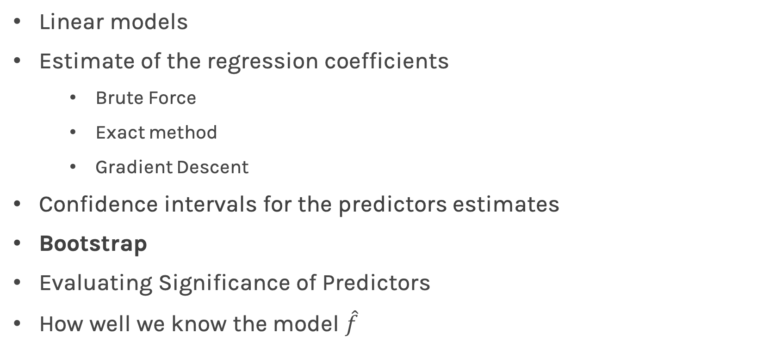
Collinearity
Three individual models
One model
TV
Coef. | Std.Err. | t | P>|t| | [0.025 | 0.975]
6.679 | 0.478 | 13.957 | 2.804e-31 | 5.735 | 7.622
0.048 | 0.0027 | 17.303 | 1.802e-41 | 0.042 | 0.053
RADIO
 | Coef. | Std.Err. | t | P>|t| | [0.025 | 0.975]
$$β_{0}$$ | 2.602 | 0.332 | 7.820 | 3.176e-13 | 1.945 | 3.258
$$β_{TV}$$ | 0.046 | 0.0015 | 29.887 | 6.314e-75 | 0.043 | 0.049
$$β_{RADIO}$$ | 0.175 | 0.0094 | 18.576 | 4.297e-45 | 0.156 | 0.194
$$β_{NEWS}$$ | 0.013 | 0.028 | 2.338 | 0.0203 | 0.008 | 0.035
Coef. | Std.Err. | t | P>|t| | [0.025 | 0.975]
9.567 | 0.553 | 17.279 | 2.133e-41 | 8.475 | 10.659
0.195 | 0.020 | 9.429 | 1.134e-17 | 0.154 | 0.236
NEWS
Coef. | Std.Err. | t | P>|t| | [0.025 | 0.975]
11.55 | 0.576 | 20.036 | 1.628e-49 | 10.414 | 12.688
0.074 | 0.014 | 5.134 | 6.734e-07 | 0.0456 | 0.102

Slide 11
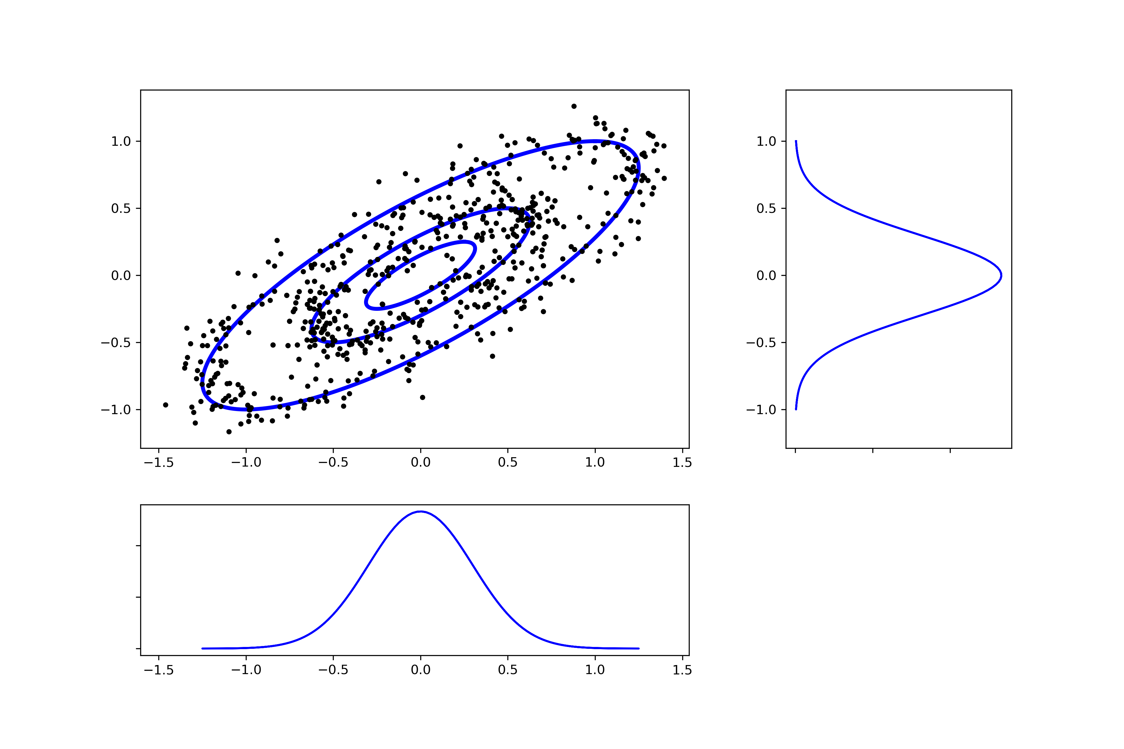
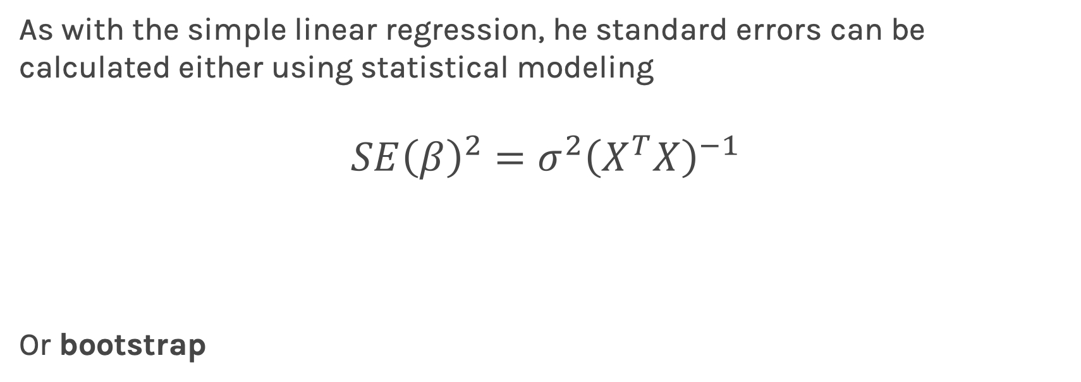
Standard Errors for Multiple Linear Regression
As with the simple linear regression, he standard errors can be calculated either using statistical modeling
$$SE{\left(β\right)}^{2}=σ^{2}{\left(X^{T}X\right)}^{−1}$$
Or bootstrap
Notes:
We need a figure here

Slide 12
Collinearity
Collinearity refers to the case in which two or more predictors are correlated (related).
We will re-visit collinearity in the next lecture when we address overfitting, but for now we want to examine how does collinearity affects our confidence on the coefficients and consequently on the importance of those coefficients.
Notes:
We need a figure here

Slide 13
Collinearity
Three individual models
One model
TV
Coef. | Std.Err. | t | P>|t| | [0.025 | 0.975]
6.679 | 0.478 | 13.957 | 2.804e-31 | 5.735 | 7.622
0.048 | 0.0027 | 17.303 | 1.802e-41 | 0.042 | 0.053
RADIO
 | Coef. | Std.Err. | t | P>|t| | [0.025 | 0.975]
$$β_{0}$$ | 2.602 | 0.332 | 7.820 | 3.176e-13 | 1.945 | 3.258
$$β_{TV}$$ | 0.046 | 0.0015 | 29.887 | 6.314e-75 | 0.043 | 0.049
$$β_{RADIO}$$ | 0.175 | 0.0094 | 18.576 | 4.297e-45 | 0.156 | 0.194
$$β_{NEWS}$$ | 0.013 | 0.028 | 2.338 | 0.0203 | 0.008 | 0.035
Coef. | Std.Err. | t | P>|t| | [0.025 | 0.975]
9.567 | 0.553 | 17.279 | 2.133e-41 | 8.475 | 10.659
0.195 | 0.020 | 9.429 | 1.134e-17 | 0.154 | 0.236
NEWS
Coef. | Std.Err. | t | P>|t| | [0.025 | 0.975]
11.55 | 0.576 | 20.036 | 1.628e-49 | 10.414 | 12.688
0.074 | 0.014 | 5.134 | 6.734e-07 | 0.0456 | 0.102

Slide 14
Qualitative Predictors
So far, we have assumed that all variables are quantitative. But in practice, often some predictors are qualitative.
Example: The credit data set contains information about balance, age, cards, education, income, limit , and rating for a number of potential customers.
Income | Limit | Rating | Cards | Age | Education | Gender | Student | Married | Ethnicity | Balance
14.890 | 3606 | 283 | 2 | 34 | 11 | Male | No | Yes | Caucasian | 333
106.02 | 6645 | 483 | 3 | 82 | 15 | Female | Yes | Yes | Asian | 903
104.59 | 7075 | 514 | 4 | 71 | 11 | Male | No | No | Asian | 580
148.92 | 9504 | 681 | 3 | 36 | 11 | Female | No | No | Asian | 964
55.882 | 4897 | 357 | 2 | 68 | 16 | Male | No | Yes | Caucasian | 331

Slide 15
Qualitative Predictors
If the predictor takes only two values, then we create an indicator or dummy variable that takes on two possible numerical values.
For example for the gender, we create a new variable:
We then use this variable as a predictor in the regression equation.

Slide 16
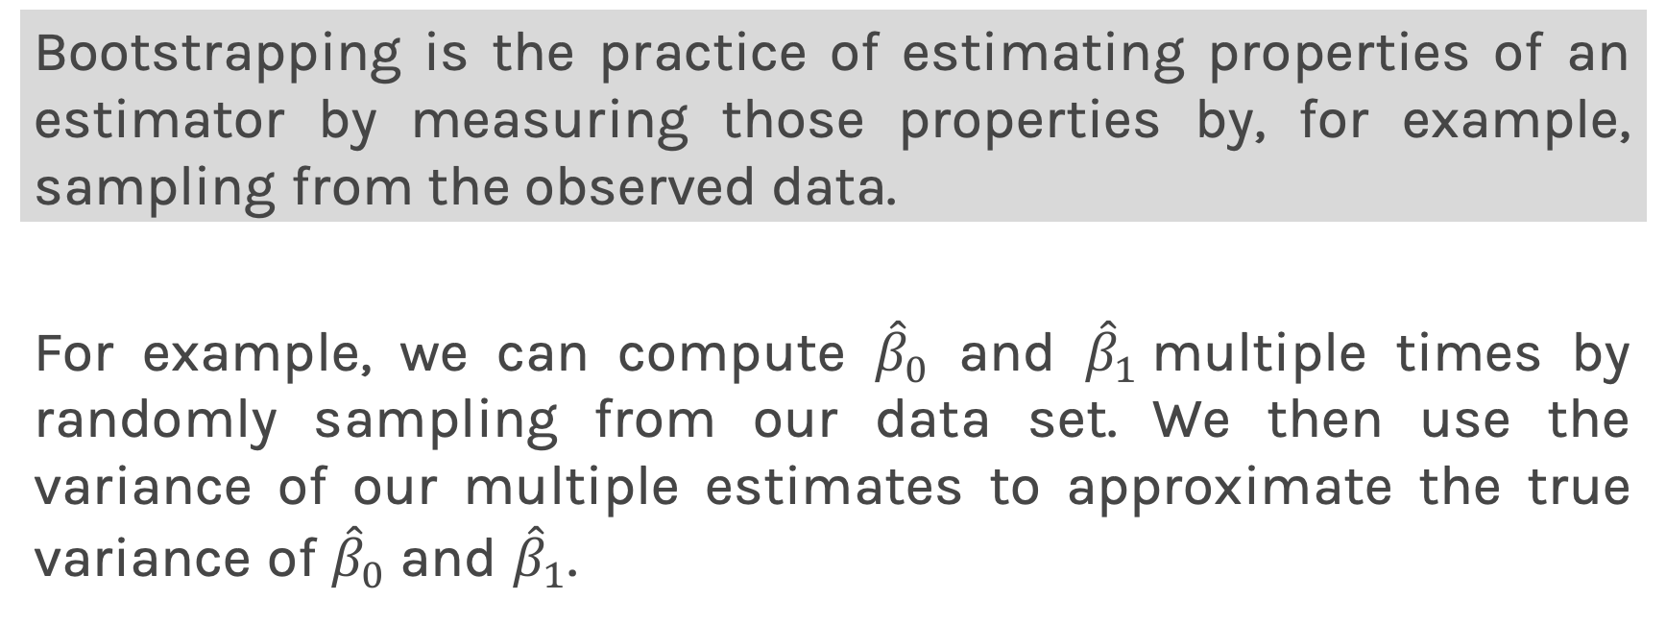
Qualitative Predictors
Question: What is interpretation of $β_{0}$ and $β_{1}$?

Slide 17
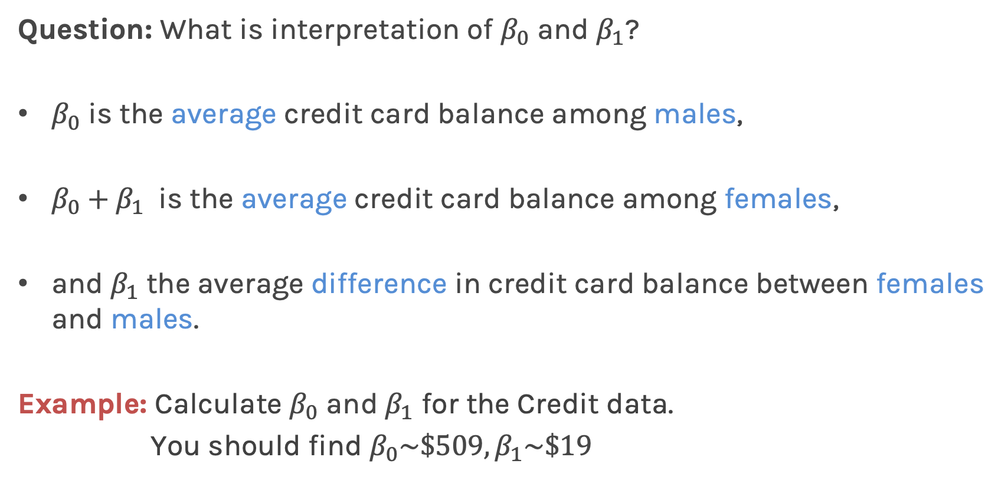
Qualitative Predictors
Question: What is interpretation of $β_{0}$ and $β_{1}$?
$β_{0}$ is the average credit card balance among males,
$β_{0}+β_{1}$ is the average credit card balance among females,
and $β_{1}$ the average difference in credit card balance between females and males.
Example: Calculate $β_{0}$ and $β_{1}$ for the Credit data.
You should find $β_{0}\sim \$509,β_{1}\sim \$19$

Slide 18
More than two levels: One hot encoding
Often, the qualitative predictor takes more than two values (e.g. ethnicity in the credit data).
In this situation, a single dummy variable cannot represent all possible values.
We create additional dummy variable as:

Slide 19
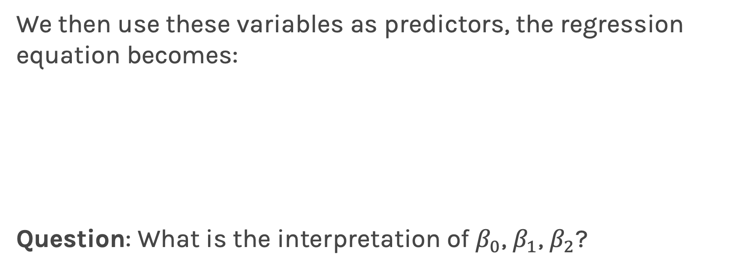
More than two levels: One hot encoding
We then use these variables as predictors, the regression equation becomes:
Question: What is the interpretation of $β_{0}$, $β_{1}$, $β_{2}$?
Notes:
[ADD interpretation and ONE HOT ENCODING]

Slide 20
Collinearity
Collinearity and multicollinearity refers to the case in which two or more predictors are correlated (related).
Limit and Rating are highly correlated
Both limit and rating have positive coefficients, but it is hard to understand if the balance is higher because of the rating or is it because of the limit? If we remove limit then we achieve almost the same model performance but the coefficients change.
The regression coefficients are not uniquely determined. In turn it hurts the interpretability of the model as then the regression coefficients are not unique and have influences from other features.
Notes:
We need a figure here

Slide 21
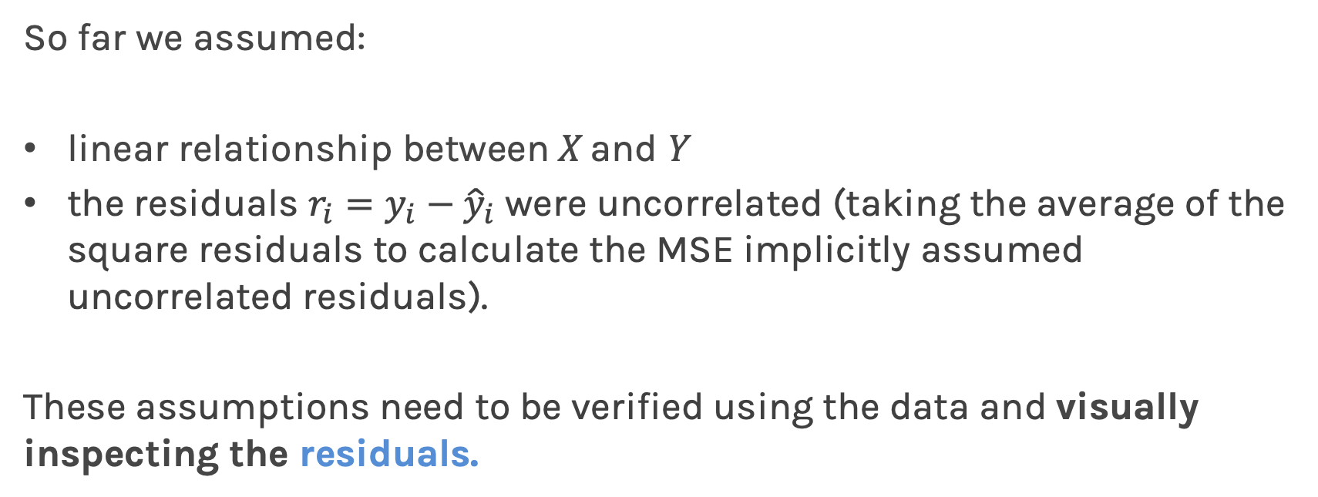
Beyond linearity
So far we assumed:
linear relationship between X and Y
the residuals $r_{i}=y_{i}−{\hat{y}}_{i}$ were uncorrelated (taking the average of the square residuals to calculate the MSE implicitly assumed uncorrelated residuals).
These assumptions need to be verified using the data and visually inspecting the residuals.

Slide 22
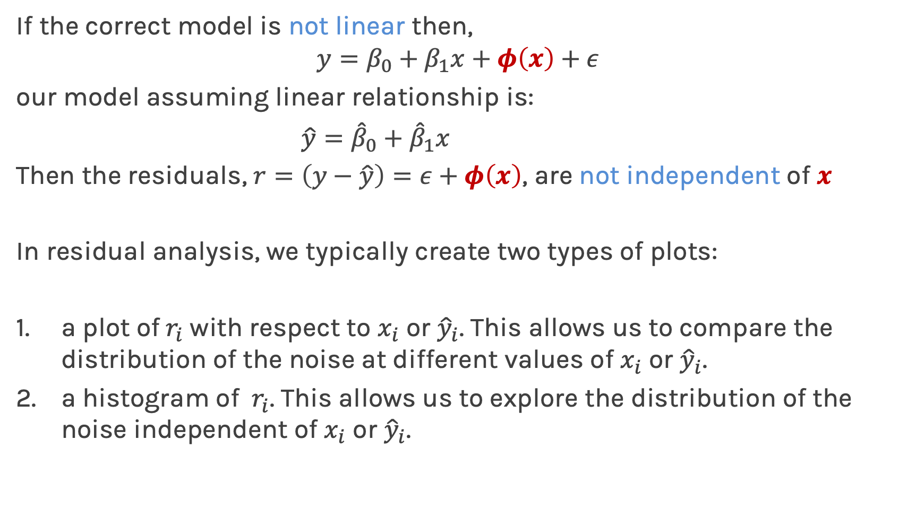
Residual Analysis
If the correct model is not linear then,
$$y=β_{0}+β_{1}x+φ\left(x\right)+ε$$
our model assuming linear relationship is:
$\hat{y}={\hat{β}}_{0}+{\hat{β}}_{1}x$
Then the residuals, $r=\left(y−\hat{y}\right)=ε+φ\left(x\right)$, are not independent of $x$
In residual analysis, we typically create two types of plots:
a plot of${ r}_{i}$with respect to $x_{i}$ or ${\hat{y}}_{i}$. This allows us to compare the distribution of the noise at different values of $x_{i}$ or ${\hat{y}}_{i}$.
a histogram of ${ r}_{i}$. This allows us to explore the distribution of the noise independent of $x_{i}$ or ${\hat{y}}_{i}$.

Slide 23
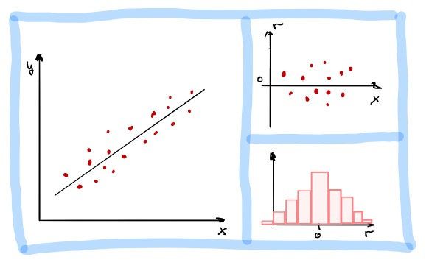
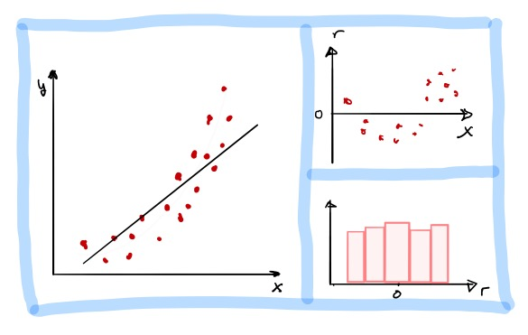
Residual Analysis
Linear assumption is correct. There is no obvious relationship between residuals and x. Histogram of residuals is symmetric and normally distributed.
Linear assumption is incorrect. There is an obvious relationship between residuals and x. Histogram of residuals is symmetric but not normally distributed.
Note: For multi-regression, we plot the residuals vs predicted y, $\hat{y},$ since there are too many x’s and that could wash out the relationship.

Slide 24

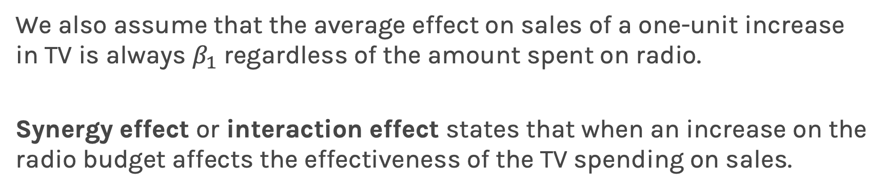
Beyond linearity: synergy effect or interaction effect
We also assume that the average effect on sales of a one-unit increase in TV is always $β_{1}$ regardless of the amount spent on radio.
Synergy effect or interaction effect states that when an increase on the radio budget affects the effectiveness of the TV spending on sales.
We change
$$Y=β_{0}+β_{1}X_{1}+β_{2}X_{2}+ε$$
to:
$$Y=β_{0}+β_{1}X_{1}+β_{2}X_{2}+β_{3}X_{1}X_{2}+ε$$

Slide 25
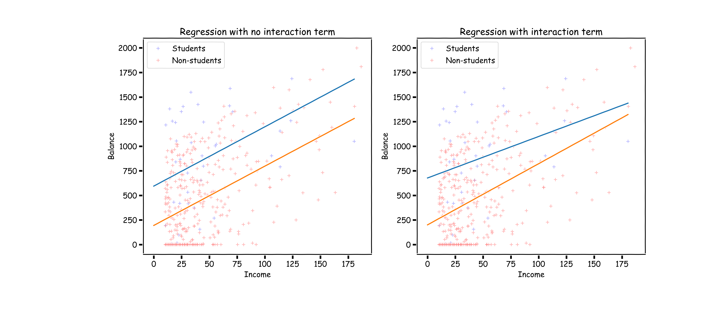
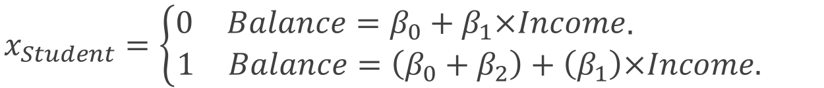
What does it mean?
$$x_{Student}=\left\{\begin{aligned}\begin{matrix}0 & Balance=β_{0}+β_{1}×Income\end{matrix}. \\ \begin{matrix}1 & Balance=\left(β_{0}+β_{2}\right)+\left(β_{1}\right)×Income. \end{matrix}\end{aligned}\right.$$

Slide 26

What does it mean?
$$x_{Student}=\left\{\begin{aligned}\begin{matrix}0 & Balance=β_{0}+β_{1}×Income\end{matrix}. \\ \begin{matrix}1 & Balance=\left(β_{0}+β_{2}\right)+\left(β_{1}\right)×Income. \end{matrix}\end{aligned}\right.$$
$$x_{Student}=\left\{\begin{aligned}\begin{matrix}0 & Balance=β_{0}+β_{1}×Income\end{matrix}. \\ \begin{matrix}1 & Balance=\left(β_{0}+β_{2}\right)+\left(β_{1}+β_{3}\right)×Income\end{matrix}\end{aligned}\right.$$

Slide 27
Too many predictors, collinearity and too many interaction terms leads to OVERFITTING!

Slide 29
Polynomial Regression

Slide 30
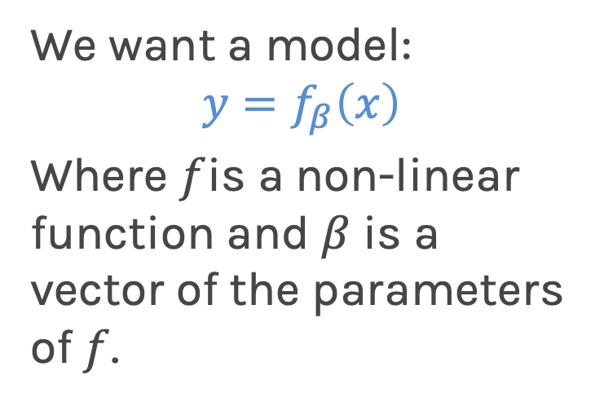
Fitting non-linear data
Multi-linear models can fit large datasets with many predictors. But the relationship between predictor and target isn’t always linear.
We want a model:
$$y=f_{β}\left(x\right)$$
Where $f$is a non-linear function and $β$ is a vector of the parameters of $f$.

Slide 31
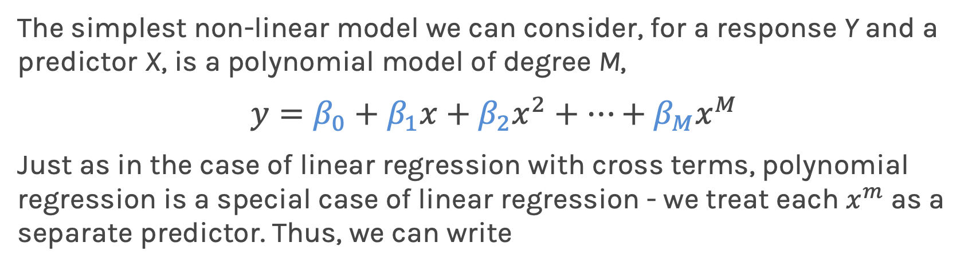
Polynomial Regression
The simplest non-linear model we can consider, for a response Y and a predictor X, is a polynomial model of degree M,
$$y=β_{0}+β_{1}x+β_{2}x^{2}+…+β_{M}x^{M}$$
Just as in the case of linear regression with cross terms, polynomial regression is a special case of linear regression - we treat each $x^{m}$ as a separate predictor. Thus, we can write

Slide 32
Polynomial Regression
This looks a lot like multi-linear regression where the predictors are powers of x!
Multi-Regression
n
Poly-Regression

Slide 33
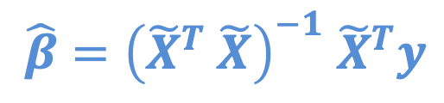
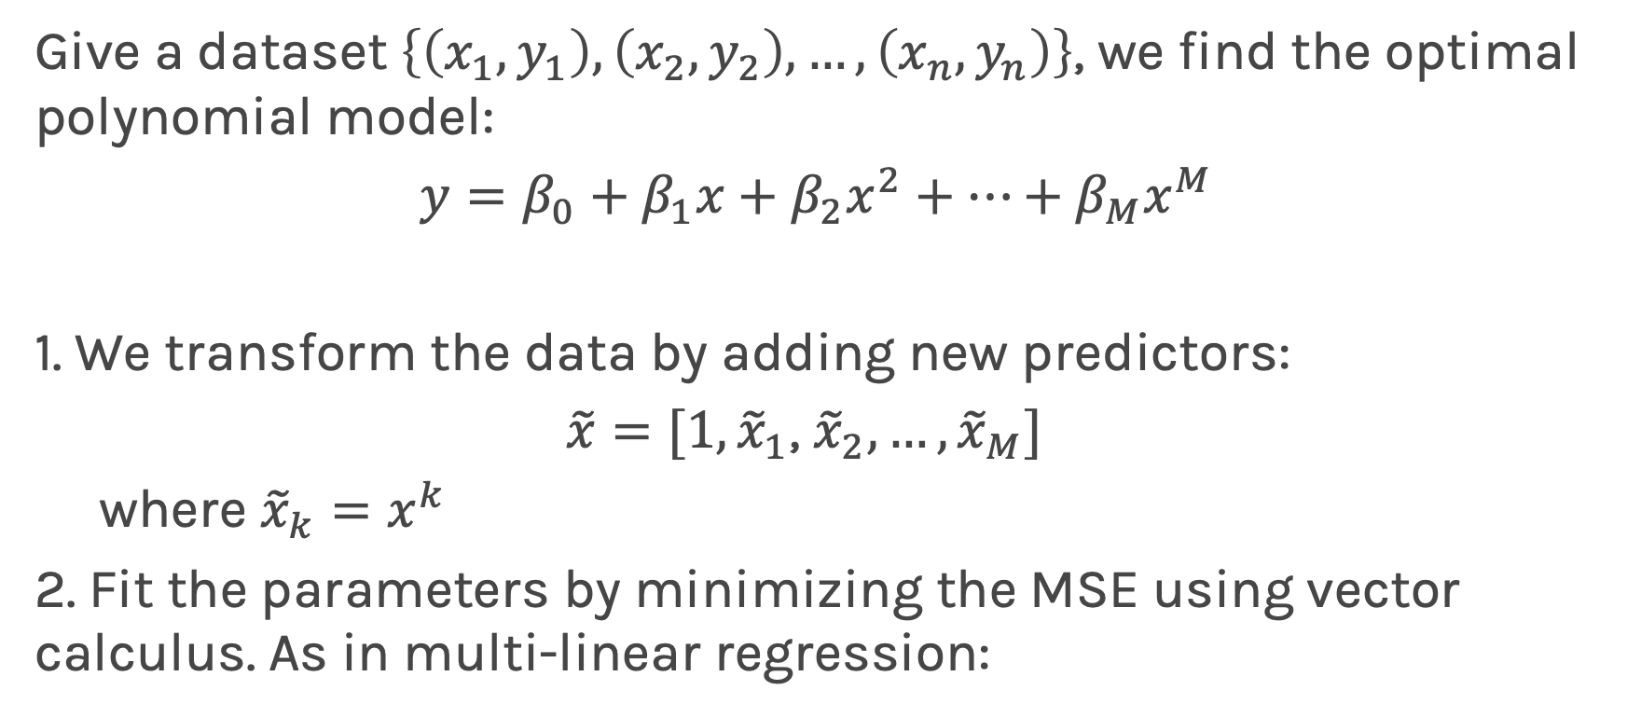
Model Training
Give a dataset $\left\{\left(x_{1},y_{1}\right),\left(x_{2},y_{2}\right), …, \left(x_{n},y_{n}\right)\right\}$, we find the optimal polynomial model:
$y=β_{0}+β_{1}x+β_{2}x^{2}+…+β_{M}x^{M}$
1. We transform the data by adding new predictors:
$\tilde{x}=[1, {\tilde{x}}_{1}$, ${\tilde{x}}_{2}, …,{\tilde{x}}_{M}]$
where ${\tilde{x}}_{k}=x^{k}$
2. Fit the parameters by minimizing the MSE using vector calculus. As in multi-linear regression:
$$\hat{β}={\left({\tilde{X}}^{T} \tilde{X}\right)}^{−1} {\tilde{X}}^{T}y$$

Slide 34
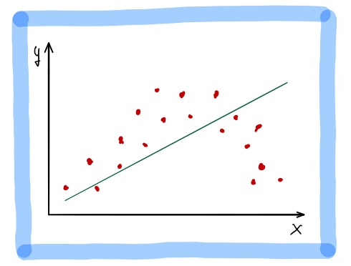
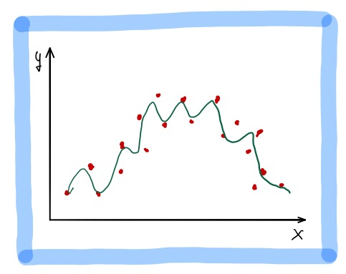
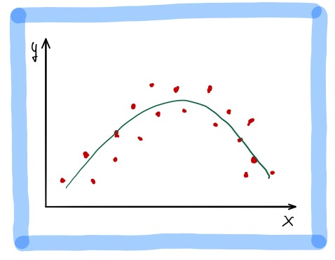
Polynomial Regression (cont)
Fitting a polynomial model requires choosing a degree.
Degree 1
Degree 2
Degree 50
Underfitting: when the degree is too low, the model cannot fit the trend.
We want a model that fits the trend and ignores the noise.
Overfitting: when the degree is too high, the model fits all the noisy data points.

Slide 35
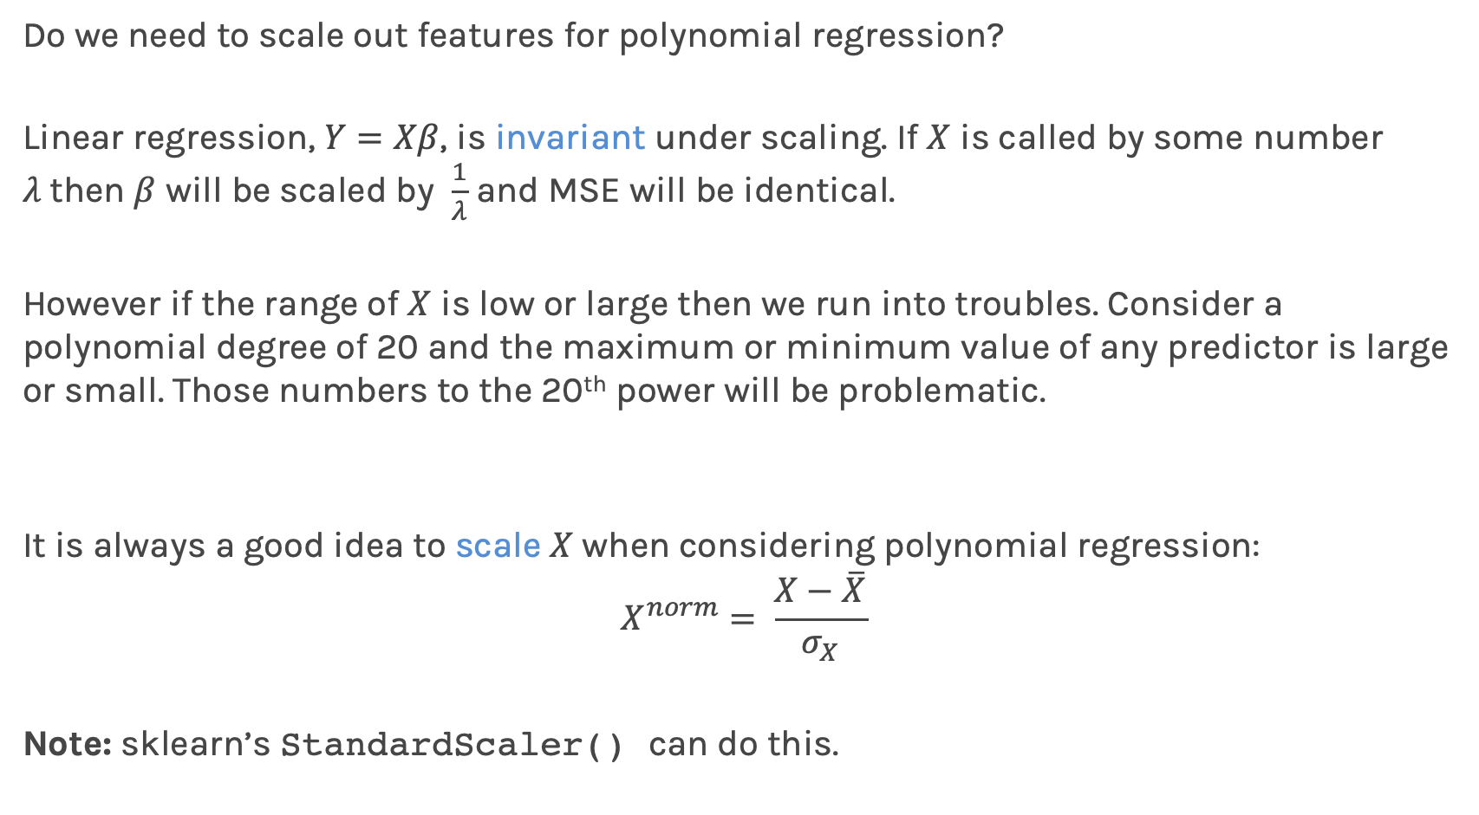
Feature Scaling
Do we need to scale out features for polynomial regression?
Linear regression, $Y=Xβ$, is invariant under scaling. If $X$ is called by some number $λ$then $β$ will be scaled by $\frac{1}{λ}$ and MSE will be identical.
However if the range of $X$ is low or large then we run into troubles. Consider a polynomial degree of 20 and the maximum or minimum value of any predictor is large or small. Those numbers to the 20th power will be problematic.
It is always a good idea to scale $X$when considering polynomial regression:
$$X^{norm}= \frac{X−\overline{X}}{σ_{X}}$$
Note: sklearn’s StandardScaler() can do this.

Slide 36
High degree of polynomial leads to OVERFITTING!

Slide 37
Ex B.1, B.2 & B.3

